Slide 1
Operator Lifecycle Manager

Slide 2
Agenda
Overview of OLM
OLM Components
High Level Walkthrough
Operator Packaging
Embedded Hub

Slide 3
What is the Operator Lifecycle Manager?

Slide 4
OLM handles the...
Installation
Definition
Resolution
Upgrading
… of your operator(s) in OpenShift clusters.

Slide 5
But what exactly is OLM
OLM is an operator that manages your operators
OLM’s architecture consists of three operators actually:
olm-operator
catalog-operator
package-server

Slide 6
CRDs managed by OLM and Catalog operators And therefore made available to administrators
ClusterServiceVersion
InstallPlan
CatalogSource
Subscription
OperatorGroup
Notes:
ClusterServiceVersion - olm
InstallPlan - catalog
CatalogSource - catalog
Subscription - catalog
OperatorGroup - olm

Slide 7
Resources created by OLM and Catalog operators
Deployments
ServiceAccounts
(Cluster)Roles
(Cluster)RoleBindings
CustomResourceDefinitions (CRDs)
ClusterServiceVersions (CSVs)
Notes:
Deployments - olm
ServiceAccounts - olm
(Cluster)Roles - olm
(Cluster)RoleBindings - olm
CustomResourceDefinitions (CRDs) - catalog
ClusterServiceVersions (CSVs) - catalog

Slide 8
An Operator for your Operators
Why Should You Use OLM?
Over-the-Air Updates and Catalogs
Dependency Model
Discoverability
Cluster Stability
Declarative UI Controls
Notes:
over the air updates and catalogs - kubernetes clusters allow for updating automatically and in the background so olm follows this tradition utilizing the catalog and channels; both of which we’ll discuss
olm’s packaging format allow expressing dependencies on the platform and other operators
by advertising operators and their services into the namespaces of tenants olm enables discover of operators available to install
stability here is the fact that operators must claim ownership of their APIs; olm prevents conflicting operators owning the same APIs
finally through the use of spec and status descriptors olm allows graphical consoles to offer a managed service provider like experience

Slide 9
An Operator for your Operators
Cluster Admins and Developers can rely on OLM
Operator Installation and Management
Dependency Resolution
Working similar to Package Management
Operator Groups
Notes:
while it may not be difficult to install an operator initially, upgrades, management, and sometimes yes even installation can involve a great deal of toil which olm can take off our hands. we already talked about descriptors for GUIs as one benefit here for example. olm’s packaging makes installation and management consistent and somewhat trivial.
developing more than one operator and need one to depend on the other, or do you want to depend on an existing operator you know exists in say an openshift cluster, olm’s dependency management has you covered
working similar to package management olm will not only attempt to verify that all the required APIs for your operator installation exist but also attempt to find an operator that owns the required APIs and install it
finally operatorgroups are a great tool to help cluster administrators lock down certain aspects of the operator which because of their introduction basically allow for not only cluster admins to install operators but also normal cluster users.

Slide 10
OLM Components

Slide 11
CatalogSource
A CatalogSource represents a store of metadata that OLM can query to discover and install operators and their dependencies.
Acts as an operator index
https://olm.operatorframework.io/docs/concepts/crds/catalogsource/
Notes:
There are three primary types:
grpc with an image reference: OLM will pull the image and run the pod, which is expected to serve a compliant api.
grpc with an address field: OLM will attempt to contact the grpc api at the given address. This should not be used in most cases.
internal or configmap: OLM will parse the configmap’s data and spin up a pod that can serve the grpc api over it.

Slide 12
CatalogSources included with OpenShift
Certified Operators
have passed Red Hat OpenShift Operator Certification
Community Operators
developed by community and hosted via Github at github.com/operator-framework/community-operators
Red Hat Operators
packaged, shipped, and supported by Red Hat
Red Hat Marketplace
built in partnership by Red Hat and IBM
https://olm.operatorframework.io/docs/concepts/crds/catalogsource/

Slide 13
Subscription
Represents an intention to install an operator.
Describe which channel of an operator package to subscribe to, and whether to perform updates automatically or manually.
Defines the name and namespace of the operator.
Defines the catalog which the operator data can be found in.
https://olm.operatorframework.io/docs/concepts/crds/subscription/
Notes:
one frequently asked question is how do i know when an upgrade is available?
It is possible to identify when there is a newer version of an operator available by inspecting the status of the operator’s subscription. The value associated with the currentCSV field is the newest version that is known to OLM, and installedCSV is the version that is installed on the cluster.

Slide 14
InstallPlan
Defines a set of resources to be created in order to install or upgrade to a specific version of a ClusterService defined by a CSV.
CRDs
ServiceAccount
(Cluster)Role(s)
(Cluster)RoleBinding(s)
Vehicle for your Operator - typically a deployment
Secrets
https://olm.operatorframework.io/docs/concepts/crds/installplan/

Slide 15
ClusterServiceVersion
Represents a single version of an operator
Includes metadata such as name, description, version, icon, etc
Very similar to packaging software for a traditional operating system; think of this as when you make your:
rpm
deb
apk
Main entrypoint for packaging an operator for OLM
https://olm.operatorframework.io/docs/concepts/crds/clusterserviceversion/
Notes:
There are two important ways to think about the CSV:
Like an rpm or deb, it collects metadata about the operator that is required to install it onto the cluster.
Like a Deployment that can stamp out Pods from a template, the ClusterServiceVersion describes a template for the operator Deployment and can stamp them out.
A ClusterServiceVersion (CSV) represents a particular version a running operator on a cluster. It includes metadata such as name, description, version, repository link, labels, icon, etc. It declares owned/required CRDs, cluster requirements, and install strategy that tells OLM how to create required resources and set up the operator as a deployment.
OLM requires you to provide metadata about your operator in order to ensure that it can be kept running safely on a cluster, and to provide information about how updates should be applied as you publish new versions of your operator.
This is very similar to packaging software for a traditional operating system - think of the packaging step for OLM as the stage at which you make your rpm, deb, or apk bundle.

Slide 16
OperatorGroup
Provides rudimentary multi-tenant configuration to OLM installed operators.
Selects a set of target namespaces in which to generate required RBAC access for its member operators.
An operator is said to be a member of an OperatorGroup if its CSV exists in the same namespace as the OperatorGroup and its CSV’s InstallModes support the set of namespaces targeted by the OperatorGroup
https://olm.operatorframework.io/docs/concepts/crds/operatorgroup/
Notes:
An operator defined by CSV csv-a is said to be a member of OperatorGroup op-a in namespace ns-a if both of the following hold:
op-a is the only OperatorGroup in ns-a
csv-a's InstallModes support op-a's target namespace set
There can only be one OperatorGroup per namespace

Slide 17
Operator Install Modes
OLM is designed to support several installation “architectures”:
Single Operator watching all namespaces in the cluster
“AllNamespace”
Single Operator watching a set of namespaces
“MultiNamespace”
One Operator per namespace, watching only that namespace “OwnNamespace”
Operator installed as a singleton
“SingleNamespace”

Slide 18

Single Operator, watching all Namespaces
Examples:
Cluster Monitoring Operator: watches for ServiceMonitor and PrometheusRule objects
MongoDB: manages clusters created in a self-service manner by OCP tenants
Unique Behavior:
All tenants of the cluster can use the Operator without having to mess with CRDs. Admin can install (and upgrade) the Operator for everyone. Implemented as OperatorGroup with empty label selector (matching everything).
Operator
system namespaces
tenant namespaces
MongoDB object
MongoDB object
MongoDB object
MongoDB object
AVAILABLE IN 4.0

Slide 19
Single Operator, watching a set of Namespaces
Examples:
AMQ Streams: allow certain namespaces to create Kafka Topics on the shared Kafka cluster in self-service manner
Unique Behavior:
The set of watched or “target” namespaces is configured via the OperatorGroup object. Matched NS are injected into the Deployment of the Operator as an annotation. The Operator must know how to set up watches only in the namespaces it is configured to do.
Operator
system namespaces
tenant namespaces
Kafka Topic object
Kafka Topic object
MongoDB object
Kafka Topic object
AVAILABLE IN 4.1

Slide 20
One Operator per Namespace
Examples:
Helm Operator: built with the SDK, a custom app packaged with a Helm chart at a specific version
Unique Behavior:
Allows each NS to have a specific version of the Operator running. Implemented with an OperatorGroup with a list of specific NS.
system namespaces
tenant namespaces
object
object
object
object
AVAILABLE IN 4.1

Slide 21
Packaging Your Operator:
Bundling and Channels

Slide 22
Packaging Your Operator: Manifest Format
A directory of files with one ClusterServiceVersion is a “bundle”
redhat:mhillsma memcached-operator $ make generate && make manifests && make bundle
redhat:mhillsma memcached-operator $ tree ./bundle
./bundle
├── manifests
│ ├── cache.redhat.io_memcacheds.yaml
│ ├── memcached-operator-controller-manager-metrics-service_v1_service.yaml
│ ├── memcached-operator-controller-manager_v1_serviceaccount.yaml
│ ├── memcached-operator-manager-config_v1_configmap.yaml
│ ├── memcached-operator-metrics-reader_rbac.authorization.k8s.io_v1_clusterrole.yaml
│ └── memcached-operator.clusterserviceversion.yaml
├── metadata
│ └── annotations.yaml
├── registry.Dockerfile
└── tests
└── scorecard
└── config.yaml
4 directories, 9 files
https://github.com/operator-framework/operator-registry/blob/master/docs/design/operator-bundle.md

Slide 23
Packaging Your Operator: Bundle Image
redhat:mhillsma memcached-operator $ cat bundle.Dockerfile
FROM scratch
# Core bundle labels.
LABEL operators.operatorframework.io.bundle.mediatype.v1=registry+v1
LABEL operators.operatorframework.io.bundle.manifests.v1=manifests/
LABEL operators.operatorframework.io.bundle.metadata.v1=metadata/
LABEL operators.operatorframework.io.bundle.package.v1=memcached-operator
LABEL operators.operatorframework.io.bundle.channels.v1=alpha
LABEL operators.operatorframework.io.metrics.mediatype.v1=metrics+v1
LABEL operators.operatorframework.io.metrics.builder=operator-sdk-v1.5.0
LABEL operators.operatorframework.io.metrics.project_layout=go.kubebuilder.io/v3
# Labels for testing.
LABEL operators.operatorframework.io.test.mediatype.v1=scorecard+v1
LABEL operators.operatorframework.io.test.config.v1=tests/scorecard/
# Copy files to locations specified by labels.
COPY bundle/manifests /manifests/
COPY bundle/metadata /metadata/
COPY bundle/tests/scorecard /tests/scorecard/
https://github.com/operator-framework/operator-registry/blob/master/docs/design/operator-bundle.md

Slide 24
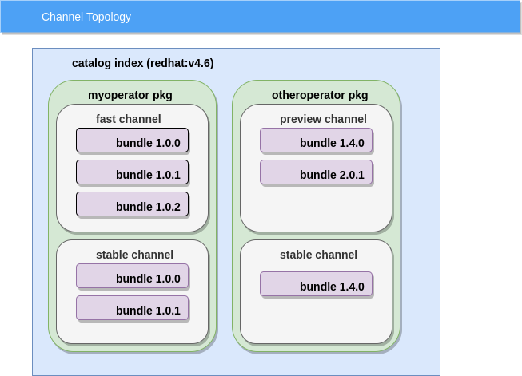
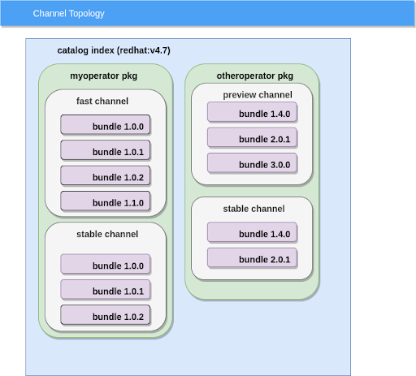
Subscription Channels
Allows for defining a set of update streams
How do we define a channel?
labels within operator bundle, specifically annotations.yaml in metadata folder
Operator deployment using channels
multiple versions can exist within a channel
latest version (head) will be installed by OLM

